Slide 1

Hangout With CODE: Setting Up
Your Virtual Drama Classroom
August 2020
Presented by Kim Snider, Brooke Charlebois & Alex Stamp

Slide 2
Our Purpose for Today’s Session
A few caveats:
We are not experts in teaching drama online, but we do hope to share some best practices and make space for collaboration
Drama is at its best when face to face; online teaching is an emergency response to COVID-19 and CODE will always advocate for in person teaching & learning
To share strategies for setting up drama courses in online contexts (hybrid models or fully remote)

Slide 3
How to Begin
Create an engaging ‘soft start’ to synchronous sessions (music, a question of the day or task for the chat)
Co-create class norms for online learning
Build trust & understand the risks of sharing online
  Make cameras optional
  Create multiple modes for participation (speaking, chat function, avatars, Jamboards, polls)
  Use breakout groups for students to apply their learning
Games (Alex)
  Let’s play some games together!

Slide 4
Games to play online
Pass the object: First pass a pen/pencil saying the name of the person first and then passing the object over the camera. That person receives the object and then says a name and passes the object. Do the same with a sheet of paper and after receiving the object, transform it into something by miming. Finally use a phone and each person improvising a brief conversation.
Dragon’s den: Put day to day problems in the chat box. As a team of 3 come up with an object that solves the problem. Host asks the first few questions then the audience asks questions
1. What is/are your names? What is your business name?
2. Partnerships: How did you choose your partner(s)? How can you be sure you will all work well together?
3. What is your product idea and why did you choose to make this product?
4. Why should someone buy your product? What makes your product stand out?
5. How much does it cost for you to manufacture one product? Where will you get your materials?
6. How many do you plan to manufacture? How many of your products do you need to manufacture and sell to break even? Is this a realistic amount to be able to sell?
7. Do you have an advertising slogan? Have any famous people used your product?
8. What inspired this product?
9. Why should everyone want your product?

Slide 5
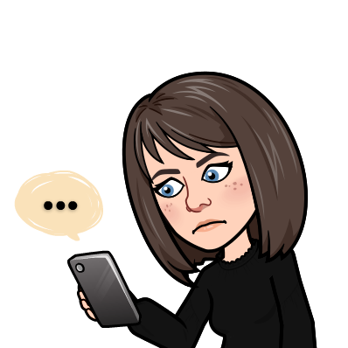
Using Tech Tools
Give students a ‘tour’ of the tech tools we will use together (Google Drive, Slides, Jamboard, Flipgrid).
Don’t assume that students know are familiar with the tech. Try to find helpers who can help you problem solve issues as they arise.
Use small group collaborative tasks to help build a community that helps students to feel comfortable working together.

Slide 6
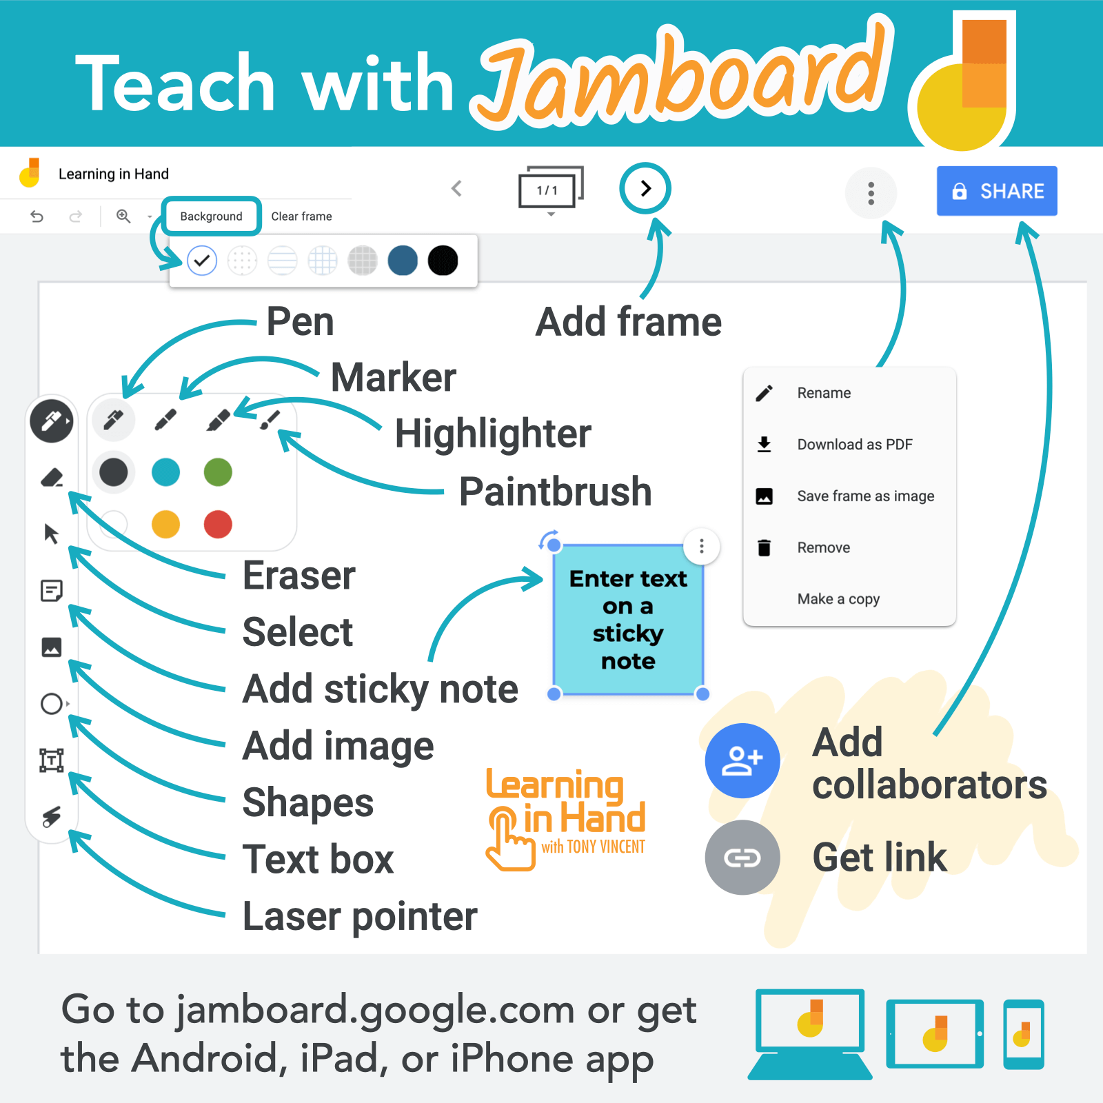
Jamboard
Use this Google app as an online bulletin board for student brainstorming, establishing class norms, documenting sources of inspiration for drama work, and more.

Slide 7
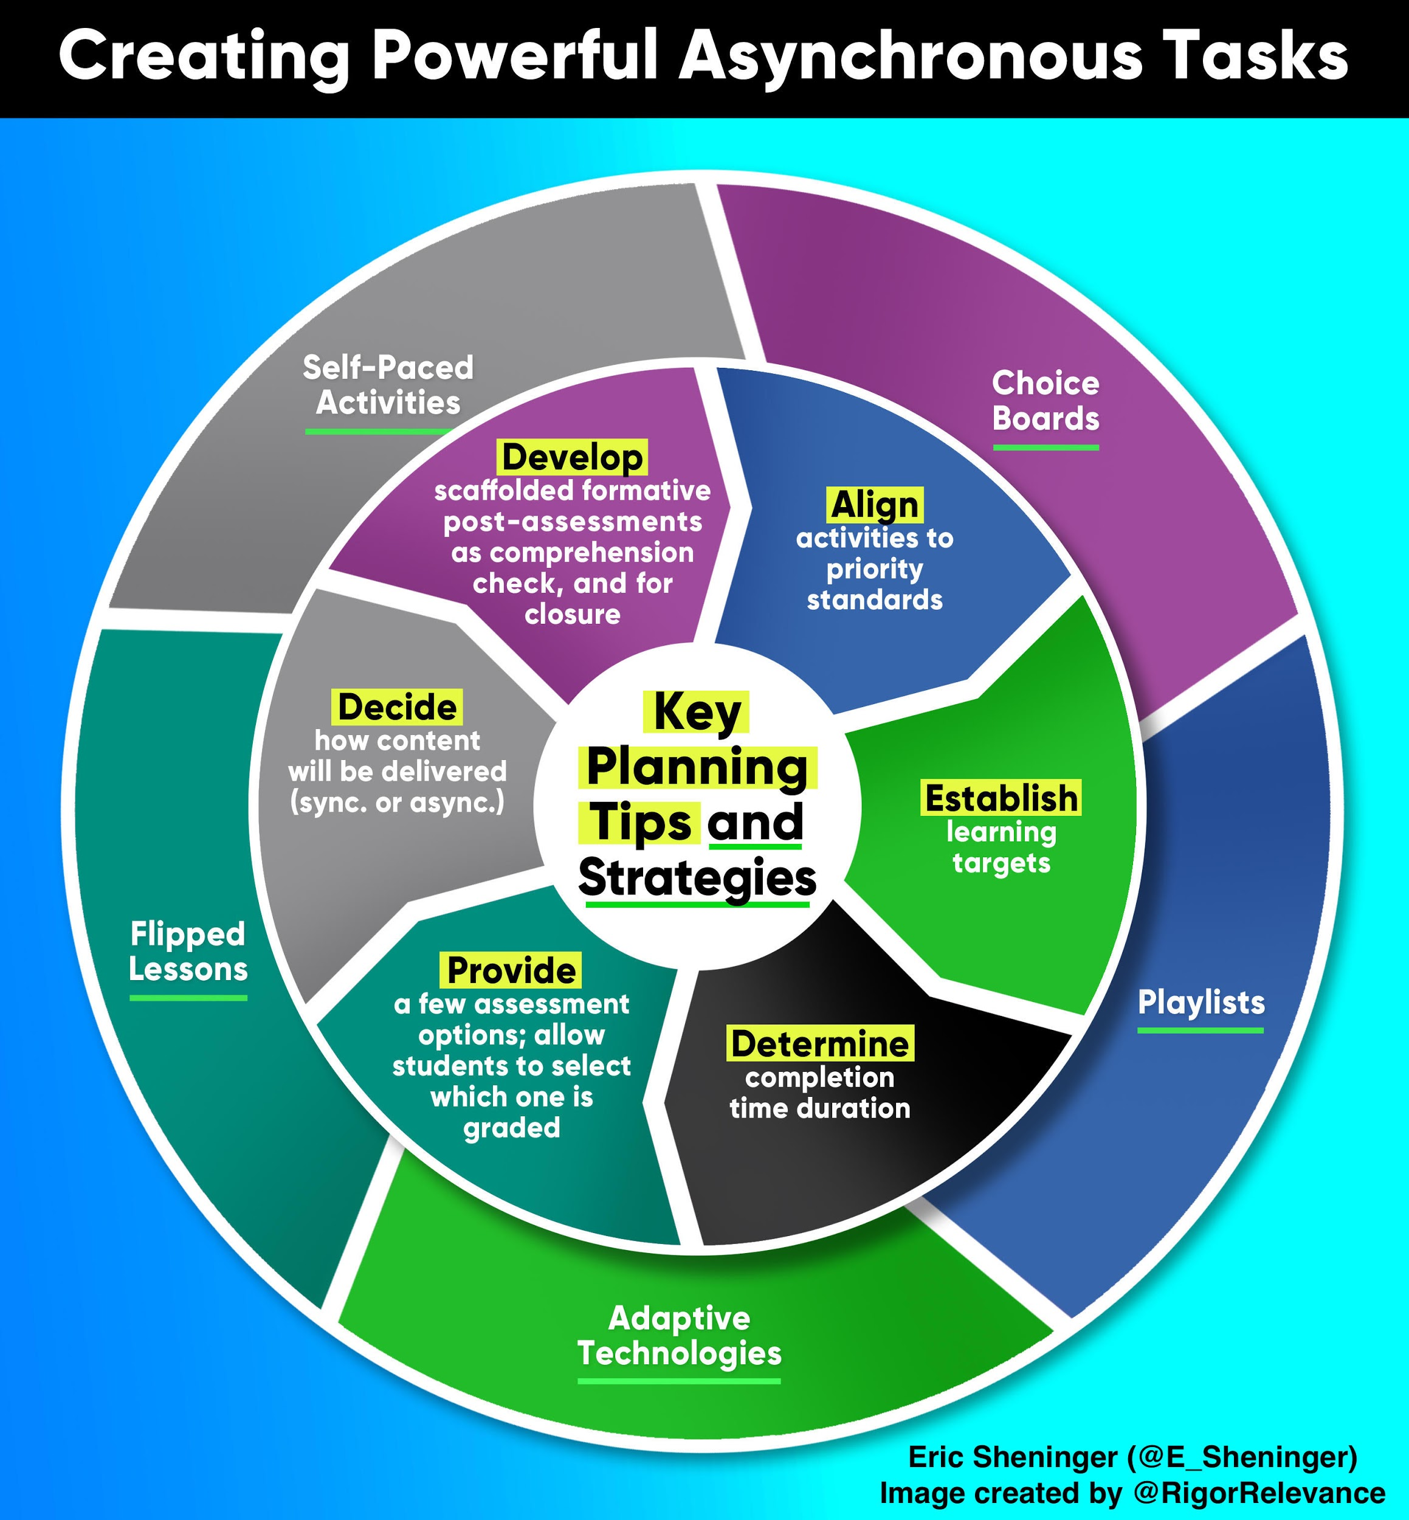
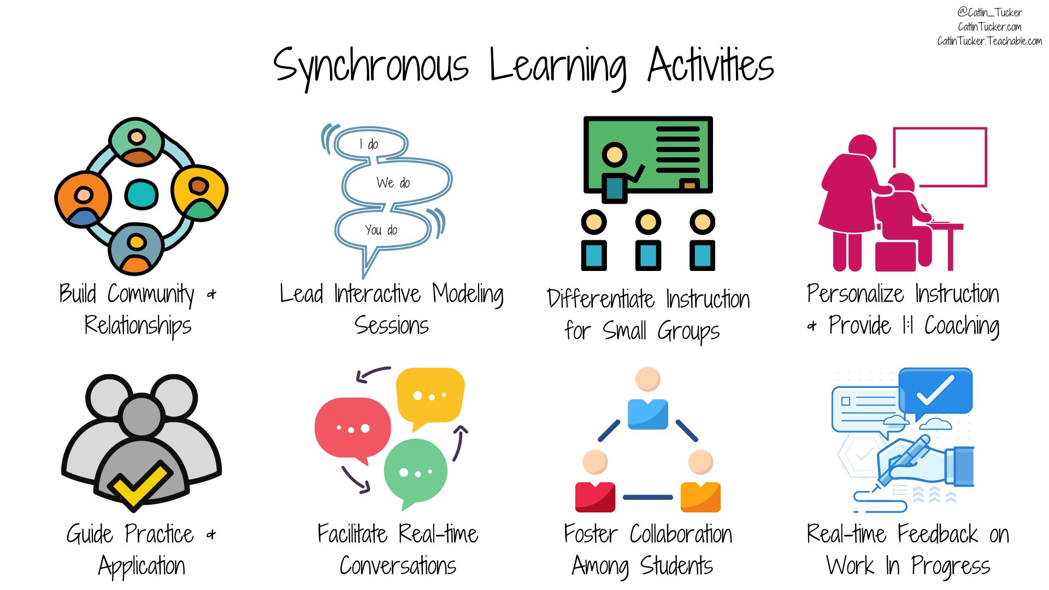
Helpful Resources: Asynch vs. Synch Teaching

Slide 8
Planning Drama Activities in Different Modes
IN SCHOOL | SYNCHRONOUS | ASYNCHRONOUS
Games Teaching drama elements and conventions Cooperative group work Devising tasks Improvisation Process drama Physical theatre Rehearsal Physically distanced performances | Adapted games Show and tell Question of the day Breakout group sharing and reflection Breakout group tasks (i.e. hot seating, improv, collaborative writing) Teaching drama styles and traditions (with Google Slides, video examples) Book/play clubs Guided reading with small group discussion Writing and brainstorming tasks (with Jamboard) Virtual visits from guest artists | Independent reading Independent writing Collaborative script writing (with Google Docs) Brainstorming (Jamboard) Virtual group rehearsal Research tasks Sourcing creative ideas for use in class Documenting out of class rehearsal Journals (written or video with Flipgrid) Recording performance work Watching recorded or posted work and giving feedback Watching filmed theatre performances

Slide 9
Structure of a Synchronous Lesson
Practice > New Learning > Groups > Whole Class > Practice
Writer’s Notebook/Brainstorm/Provocation (10min)
Teacher Directed Lesson of New Material (15min)
Small Group Application (Breakout Groups) (15min)
Brain Break (get up/move around) (5min)
Whole Class Sharing (20min)
New Material for Independent Work/Closing/Reminders (10min)
Examples of Low Tech Learning
Haiku Hikes, Journaling, Postcard Writing Building, Inventing, Designing, Crafting Sketchnoting, Drawing, Map-making Observing, Collecting Data, Predicting Creating Comics, Collages, Songs and Rhymes Interviewing, Storytelling, Playwriting Source: Kids Have All the Right Stuff

Slide 10
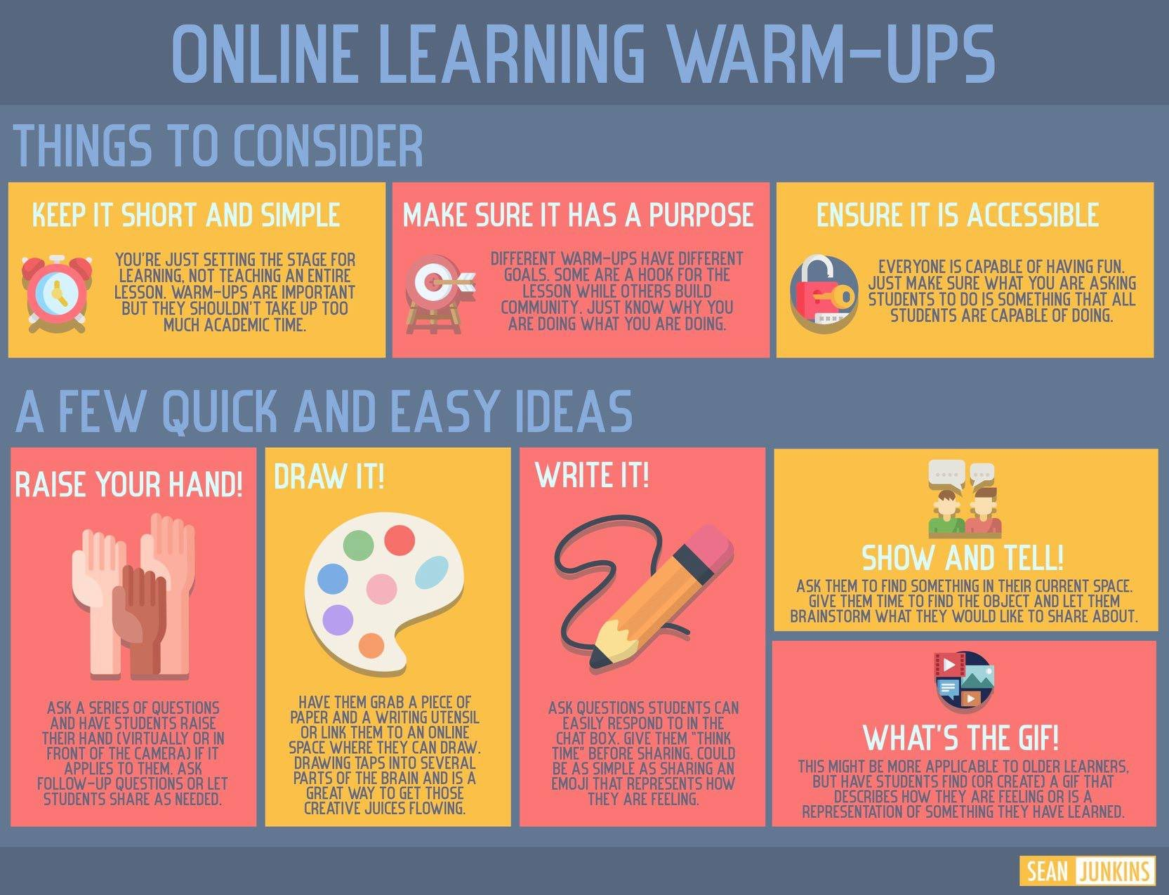
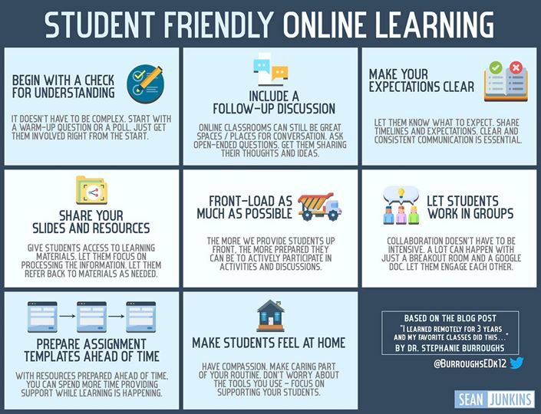
EduTwitter Resources: Sean Junkins

Slide 11
JOIN CODE
Drama and Dance: Creative Community in a Time of COVID + 18 Adapted Resources
Become a CODE member & connect with your Regional Coordinator
Other ways to connect . . .
Drama Education Resource Sharing (Canada & Beyond) FB Group
Reach out to your Board Arts Consultants
Create a Google Classroom for Staff and self-organize best practice sharing sessions

Slide 12
Please join CODE online this Saturday, October 24th!
Annual General Meeting 11am
Tribute to David Booth 1pm
CODE’s 50th Anniversary Celebration 1:45pm
www.code.on.ca
EVOLVE 2021 Conference - October 22nd-24th, 2021 Sheraton Hamilton

